Slide 1
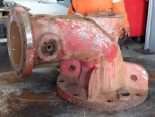
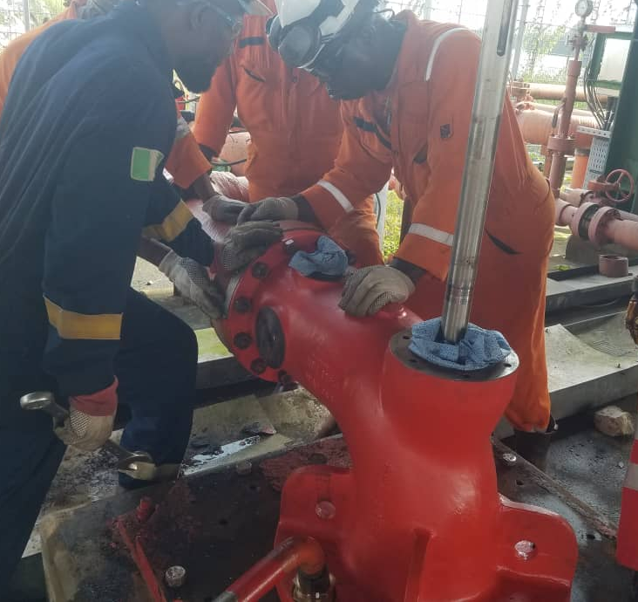
Soku Firewater Pump Restoration By Reverse Engineering, MTO ID: Id I-0458951
FIT4 ID: I-2471530
Cost Avoidance: $524,165
Challenge
Firewater Pump P-6302A failed during routine test-run activity in October 2022.
The pump discharge bend which hitherto had hairline cracks (observed in 2021) developed a significant leak that rendered it unable to deliver the required pressure of ca. 10barg. Hence, Soku fire fighting philosophy was significantly compromised.
Previous efforts to source replacement parts from the original equipment manufacturer had been froth with issues.
- Original pump division of Weir Pumps Limited had been acquired by Trillium Flow Technologies
- Pump was deemed obsolete and no support was available for pump maintenance spares
The option of a new pump was considered.
- The new OEM, Trillium Flow Technologies offered its pump VBN-DS 300/250 in place of original Weir pump SBWM 480D-V4. ExWorks offer received in March 2021 was put at € 495,800.00 with a lead time of 52 weeks
- CAPEX budget provision to procure this new pump was not approved in OP22
Solution - What the team did
An investigation by Asset, Mtce Execution (Workshop), Condition Monitoring and Mechanical Engineering discipline.
Identified issues: Build-up of silt in the firewater pit, vibration in vicinity of the pump and subsidence in the firewater area.
Agreed actions as follows:
Carryout cleaning of the pit to remove accumulated silt in the fire water pit. This desilting work has been closed-out.
Put in place temporary fire fighting philosophy owing to unavailability of P-6302A. eMoC 123695 initiated and approved.
Explore 3DP / reverse engineering methodology to produce an interchangeable discharge bend.
Resolve vibration observed from nearby firewater pump C (evidenced by gathered vibration data).
Result
With support of Mechanical discipline, reverse engineering was pursued with Nigerian Foundries Limited.
eMoC 129417 initiated, approved, Replacement bend was manufactured from scan data/composition analysis of old pump.
Cost of reverse engineering @ < F$ 20,000. Timeline from concept to implementation < 6months.
Fabrication/machining works to make final dimensional adjustments carried out in Soku Workshop
Look Ahead
Develop a work process for reverse engineering/3D printing of parts. Work with Mechanical discipline on technical paper presentation
Implement 5yearly maintenance plan to desilt the pit.
Team members
Dawodu Mike, Idio Samuel, Anyachor Nnaemeka, Digbani Tamunofiri, Esireyewun Sanni, Akinjagunla Oluwashina, Ekpoh Nsikak, Okiomah Andrew, Sani Mukhtar, Enu Alex, Taylor-harry Tamunoemi, Feboke Rosemary
Failed pump section at PH-IA Workshp
Safe Installation of Fabricated Discharge Bend

